Slide 1



the bondage of
Cults and Isms
Islam
A free CD of this message will be available following the service
It will also be available for podcast later this week at calvaryokc.com

Slide 2

Eph. 4:15 ~ … speaking the truth in love, may grow up in all things into Him who is the head — Christ
the bondage of Islam

Slide 3
Islam ~ surrender
Muhammed ~ born c. AD 571 – died, June 8, AD 632
18 wives and concubines
The “Seal of the Prophets”
the bondage of Islam

Slide 4
Birth of Muhammad c. 570
“Night journey”
620
Battle of Tours
722
1st “visions”
610
Return to Mecca
628
570
590
610
630
650
670
690
710
Began preaching
613
100 years of
expansion
“Hijira”
622
the bondage of Islam

Slide 5
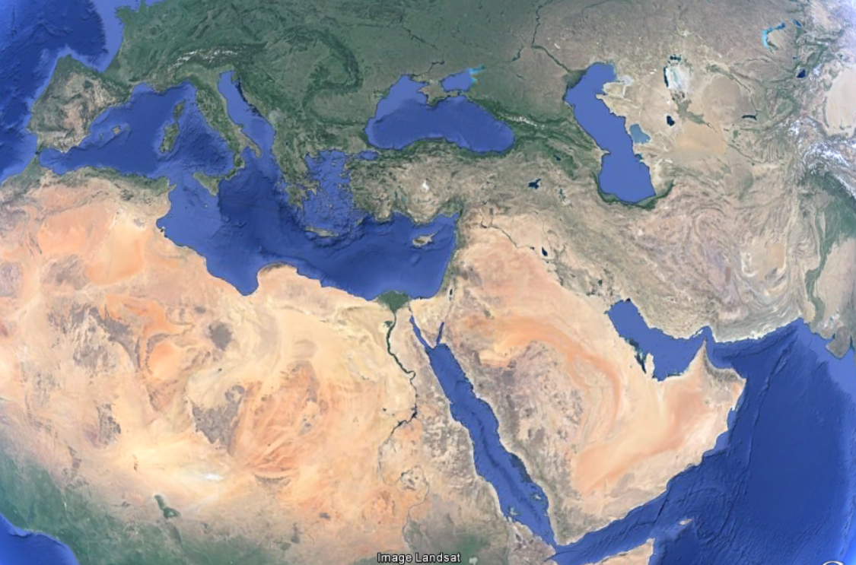
“The Qur’an or the Sword”
Islamic
expansion in
the first 100 years
the bondage of Islam

Slide 6
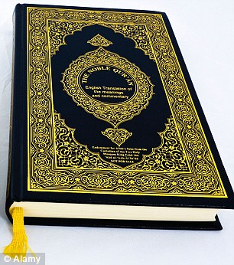
Koran ~ recitations
Qur'an
114 suras (chapters)
The Hadith ~ tradition
250 years following Muhammad’s death
Shahadah ~ “There is no god but Allah and Muhammad is his prophet”
the bondage of Islam

Slide 7
The Five Pillars of Islam
1. Reciting the Shahadah
2. Salat (daily prayers)
Toward Mecca (usually east)
Morning, noon, late afternoon, sunset and before bedtime
3. Almsgiving
4. Fasting during Ramadan
Between sunrise and sundown
the bondage of Islam

Slide 8
The Five Pillars of Islam
5. The Hajj (pilgrimage to Mecca)
Between 2-5 million each year
the bondage of Islam

Slide 9
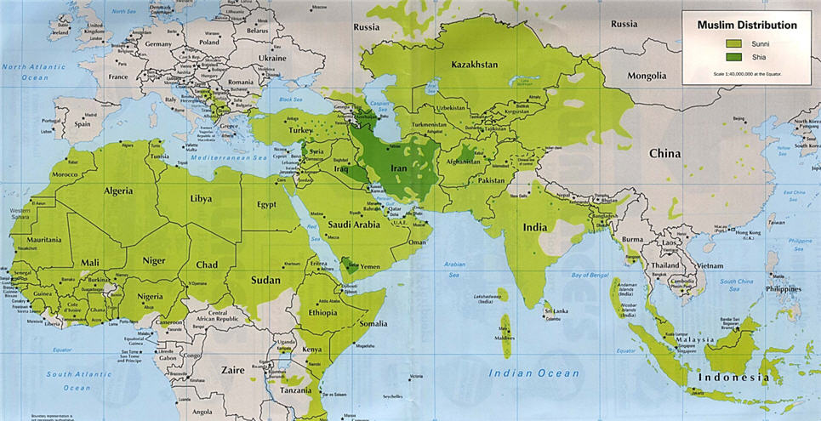
Sunni
Shiite
85-90%
10-15%
the bondage of Islam

Slide 10
Basic Tenets
Monotheistic
The Bible became corrupted
Sura 112:1-4 ~ ¹ Say: He, Allah, is One.
² Allah is He on Whom all depend.
³ He begets not, nor is He begotten.
⁴ And none is like Him.
Balance scales theology
Jihad ~ struggle or resistance
Purely spiritual
Purely defensive
Physical war against non-believers
the bondage of Islam

Slide 11
Jihad as physical war against non-believers
Taught in the Qur’an
Practiced by Muhammad
Sura 8:12 ~ I will cast terror into the hearts of those who disbelieve. Therefore strike off their heads and strike off every fingertip of them.
Exemplified in history
the bondage of Islam

Slide 12
List of Muslim terrorist attacks since 1993
1st World Trade Center bombing (Feb. 26, 1993) 6 killed)
Air France flight 8969 hijacking (Dec. 24, 1994) (3 killed)
Kobar Towers bombing (June 25, 1996) (20 killed)
Luxor, Egypt Massacre (Nov. 17, 1997) (62 killed)
the bondage of Islam

Slide 13
List of Muslim terrorist attacks since 1993
USS Cole attack (Oct. 12, 2000) (17 killed)
2nd World Trade Center bombing (Sept. 11, 2001) (almost 3,000 killed)
Jakarta Marriot hotel bombing (Aug. 5, 2003) (12 killed)
Madrid train bombings (Mar. 11, 2004) (151 killed)
the bondage of Islam

Slide 14
List of Muslim terrorist attacks since 1993
Australian Embassy, Jakarta bombing (Sept. 9, 2004) (9 killed)
London subway bombings (July 7, 2005) (53 killed)
Sharm el Sheikh resort, Egypt bombing (July 23, 2005) (64 killed)
Delhi, India bombings (Sept. 13, 2008) (130 killed)
the bondage of Islam

Slide 15
List of Muslim terrorist attacks since 1993
Mumbai, India bombings (Nov. 26, 2008) (166 killed)
Beledweyne, Somalia bombing (July 18, 2010) (35 killed))
Ahmadi Mosques bombings, Lahore, Pakistan (May 28, 2010) (100 killed)
Baghdad, Iraq bombings (Feb. 23, 2012) (83 killed)
the bondage of Islam

Slide 16
List of Muslim terrorist attacks since 1993
Baghdad, Iraq bombings (Mar. 20, 2012) (52 killed)
Boston Marathon bombings (Apr. 15, 2012) (3 killed)
Westgate Mall attack, Nairobi, Kenya (Sept. 13, 2013 (67 killed)
Peshawar, Pakistan church attack (Sept 22, 2013) (127 killed)
the bondage of Islam

Slide 17
List of Christian terrorist attacks since 1993
?
the bondage of Islam

Slide 18
the bondage of Islam

Slide 19
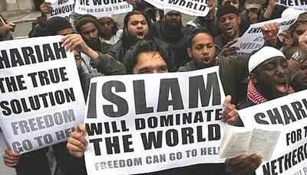
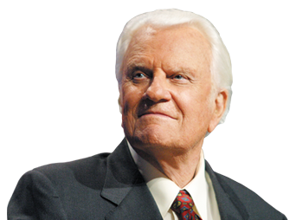
Islamic fundamentalism
Christian fundamentalism
the bondage of Islam

Slide 20
the bondage of Islam

Slide 21
What does the Qur’an say about Jesus?
Jesus was virgin born and sinless
Muhammad was neither
Jesus performed miracles
Muhammad did not
Jesus is the “Word of God”
the bondage of Islam

Slide 22
the bondage of Islam

Slide 23
What does the Qur’an say about the Bible?
Approx. 30x affirms the Scriptures as reliable
Sura 29:46-47 ~ ⁴⁶ And do not dispute with the followers of the Book except by what is best, except those of them who act unjustly, and say: We believe in that which has been revealed to us and revealed to you, and our Allah and your Allah is One, and to Him do
the bondage of Islam

Slide 24
What does the Qur’an say about the Bible?
we submit.
⁴⁷ And thus have We revealed the Book to you. So those whom We have given the Book believe in it, and of these there are those who believe in it, and none deny Our communications except the unbelievers.
the bondage of Islam

Slide 25
What does the Qur’an say about the Bible?
Sura 5:71 ~ Say: “O People of the Book! ye have no ground to stand upon unless ye stand fast by the Law, the Gospel, and all the revelation that has come to you from your Lord."
Complete manuscripts of the Bible pre-dating Muhammad by over 200 years
the bondage of Islam

Slide 26
the bondage of Islam

Slide 27
ISI
slamic
tate (of)
raq (and the)
raq (and)
S
L
evant
yria
Estimates range from 30,000 – 100,000 members
the bondage of Islam

Slide 28
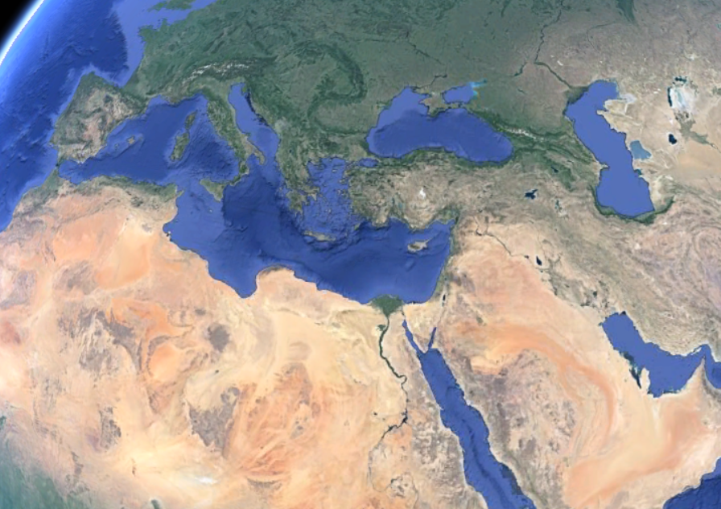
ISIS
Presently controlled
Presently claimed
Future expansion
the bondage of Islam

Slide 29
the bondage of Islam

Slide 30


(nun)
“Nazarene” or “Nestorian”
the bondage of Islam

Slide 31
the bondage of Islam

Slide 32
John 3:16-17 ~ ¹⁶ For God so loved the world that He gave His only begotten Son, that whoever believes in Him should not perish but have everlasting life. ¹⁷ For God did not send His Son into the world to condemn the world, but that the world through Him might be saved.
Islam

Slide 33
the bondage of Islam

